Slide 1
§8.4: Generating Functions
Definition: The generating function for the sequence a₀,a₁….a_{k} of real numbers is the infinite series

Slide 2
Example 1
The generating functions for the sequences {a_{k}} with a_{k} = 3, a_{k} = k + 1, and a_{k} = 2^{k} are

Slide 3
Generating Functions for Finite Sequences
Generating functions for finite sequences of real numbers can be defined by extending a finite sequence a₀,a₁, … , a_{n} into an infinite sequence by setting a_{n+1} = 0, a_{n+2} = 0, and so on.
The generating function G(x) of this infinite sequence {a_{n}} is a polynomial of degree n because no terms of the form a_{j}x^{j} with j > n occur, that is, G(x) = a₀ + a₁x + ⋯ + a_{n} x^{n}.

Slide 4



Example 2
What is the generating function for the sequence 1, 1, 1, 1, 1, 1?

Slide 5

Example 3
Let m be a positive integer. Let a_{k}= C(m, k), for k = 0, 1, 2, . . . , m. What is the generating function for the sequence a₀, a₁, . . . , a_{m}?

Slide 6




Useful Facts About Power Series
Example 4
The generating function of the sequence 1,1,1,1…
Example 5
The generating function of the sequence 1,a,a², a³…

Slide 7

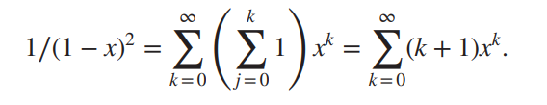
Useful Facts About Power Series
Theorem 1
Let
Example 6
Let Find the coefficients a₀, a₁,a₂, a₃… in the expansion

Slide 8
Definition 2: Let u be a real number and k a nonnegative integer. Then the extended binomial coefficient is defined by

Slide 9
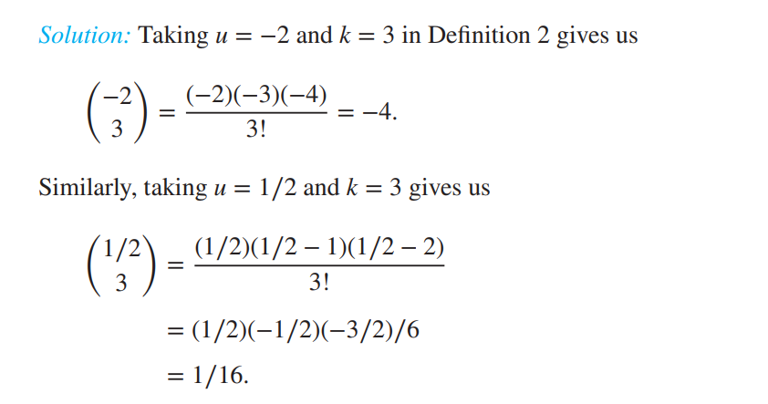
Example 7
Find the value of the extended binomial coefficient

Slide 10
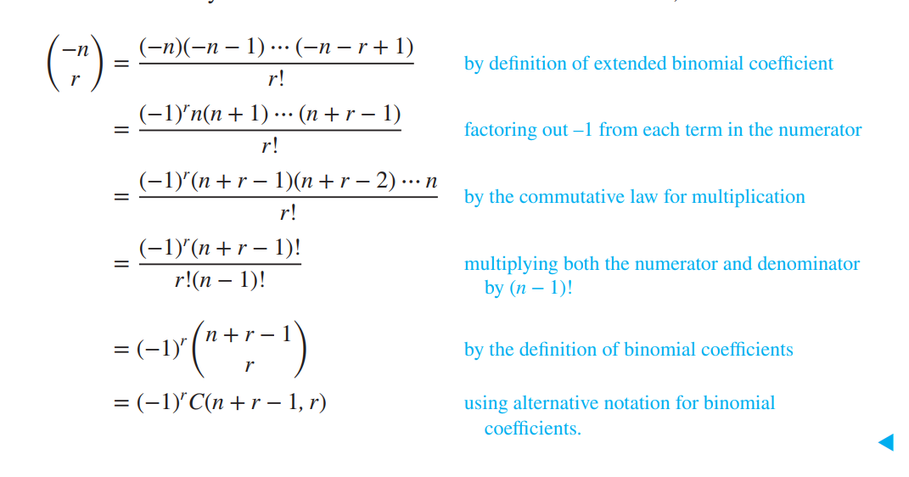
Example 8
Find the value of the extended binomial coefficient

Slide 11
The extended binomial theorem
Theorem 2
Let x be a real number with |x|<1 and let u be a real number. Then

Slide 12
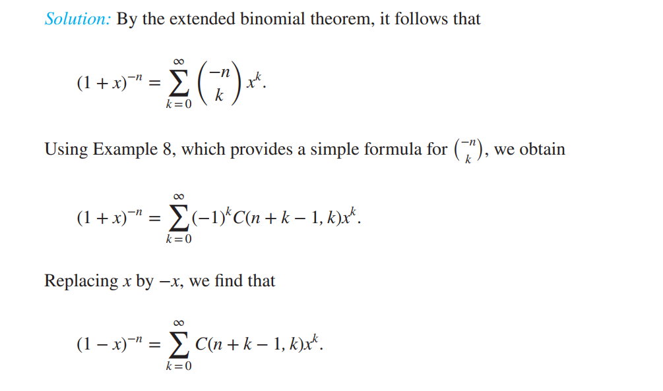
Example 9
Find the generating functions for (1 + x) ^{−n} and (1 − x) ^{−n}, where n is a positive integer, using the extended binomial theorem.

Slide 13
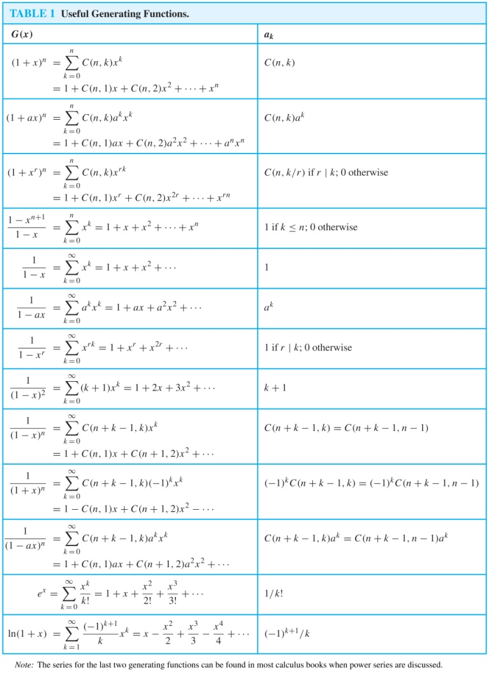
Table 1 Useful Generating Functions

Slide 14
Counting problems and Generating Functions
Example 10
Find the number of solutions of e₁+e₂+e₃ =17, where e₁, e₂, and e₃ are nonnegative integers with 2 ≤ e₁ ≤ 5, 3 ≤ e₂ ≤ 6, and 4 ≤ e₃ ≤ 7.
the coefficient of x¹⁷in this product is 3.

Slide 15


Counting problems and Generating Functions
Example 11
In how many different ways can eight identical cookies be distributed among three distinct children if each child receives at least two cookies and no more than four cookies?
the coefficient of x⁸in this product is 6.

Slide 16
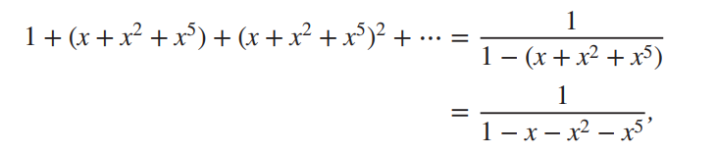

Example 12
Use generating functions to determine the number of ways to insert tokens worth $1, $2,and $5 into a vending machine to pay for an item that costs r dollars in both the cases when the order in which the tokens are inserted does not matter and when the order does matter.
(For example, there are two ways to pay for an item that costs $3 when the order in which the tokens are inserted does not matter: inserting three $1 tokens or one $1 token and a $2 token. When the order matters, there are three ways: inserting three $1 tokens, inserting a $1 token and then a $2 token, or inserting a $2 token and then a $1 token.)

Slide 17

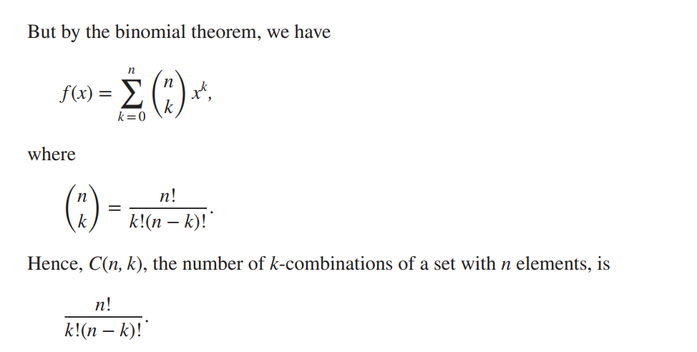
Example 13
Use generating functions to find the number of k-combinations of a set with n elements. Assume that the binomial theorem has already been established.

Slide 18
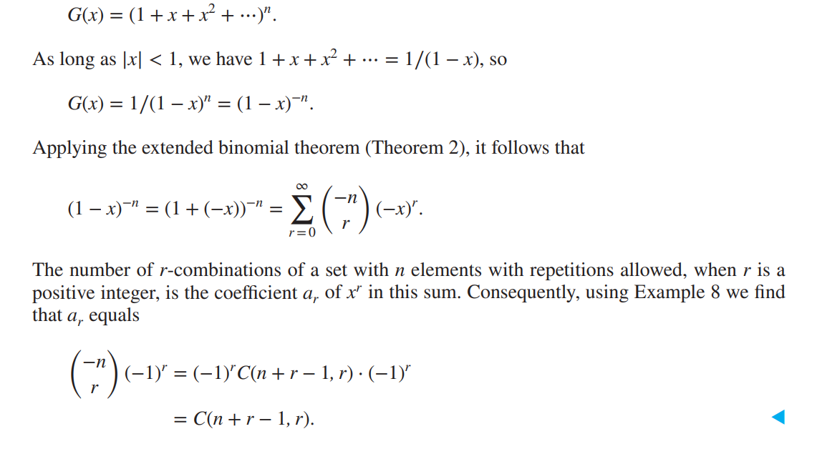
Example 14
Use generating functions to find the number of r-combinations from a set with n elements when repetition of elements is allowed.

Slide 19
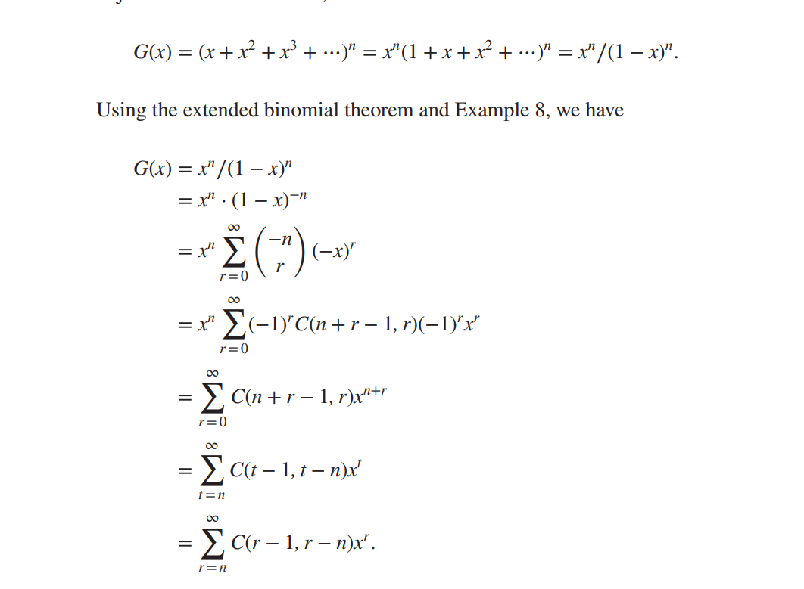
Example 15
Use generating functions to find the number of ways to select r objects of n different kinds if we must select at least one object of each kind.

Slide 20
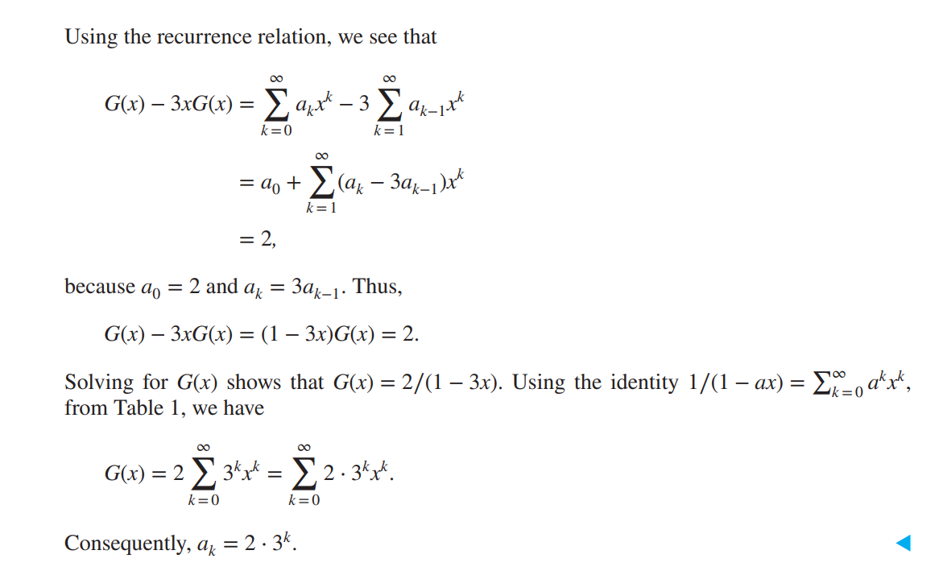

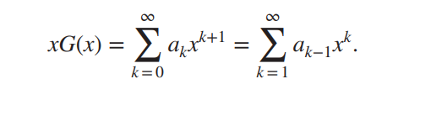
Using Generating Functions to Solve Recurrence Relations
Example 16
Solve the recurrence relation a_{k}= 3a_{k-1} for k=1,2,3… and initial condition a₀=2

Slide 21


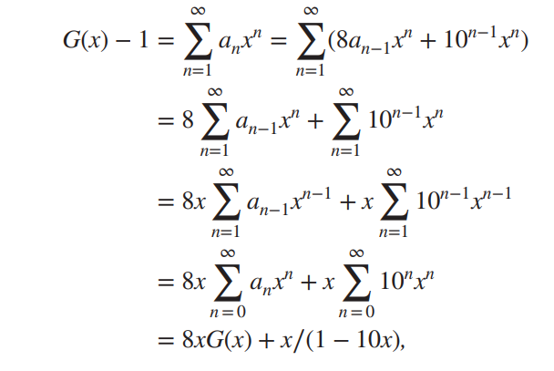


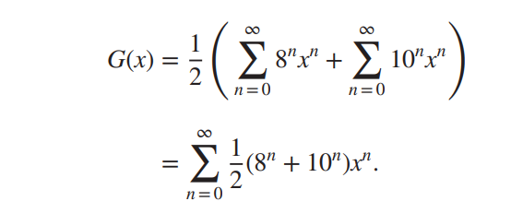
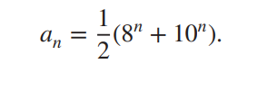
Example 17
Suppose that a valid codeword is an n-digit number in decimal notation containing an even number of 0s. Let a_{n} denote the number of valid codewords of length n. In Example 4 of Section 8.1 we showed that the sequence {a_{n}} satisfies the recurrence relation a_{n} = 8a_{n−1} + 10^{n−1} and the initial condition a₁ = 9. Use generating functions to find an explicit formula for a_{n}.

Slide 22
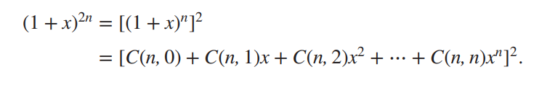
Proving Identities via Generating Functions
Example 18
Use generating functions to show that
When n is a positive integer.

Slide 23
Homework
§8.4
16, 24, 36

